Slide 1
Text to Braille Scanner with Ultra Low Cost Refreshable Braille Display
Project Guide
Prof. Neetha John
Group Members:
Akshai R Nair (MAC16EE008)
Biju Joseph (MAC16EE037)
Binila Binu (MAC16EE039)
Eldho John Menachery (MAC16EE048)

Slide 2
Contents
Objective
Hardware
Software
Block Diagram
Working Video
Work Report

Slide 3
Objective
Create a low cost braille display with stepper motors
Develop picture to braille display conversion for the ease of use
Create a reliable and ergonomic setup that blind people can easily interact

Slide 4
Slider Mechanism
Sliders are attached to stepper motors
When receiving a pulse signal, it will move a fixed distance according to the direction set for the stepper motor.
The combination of dots appearing in the slot changes according to the position of 2 sliders
With the unique pattern of sliders any braille Alphabettt can be made by their combination

Slide 5
Image Processing Using Python
Google Tesseract is used for optical character recognition
OCR will fail if the image has a noisy backgroun
To improve OCR efficiency we use image processing methods in python
First background noise is removed.
Thresholding is done to make white pixels more white and black pixels more black

Slide 6
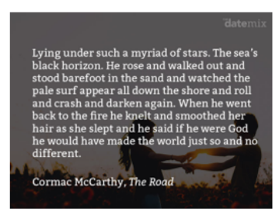
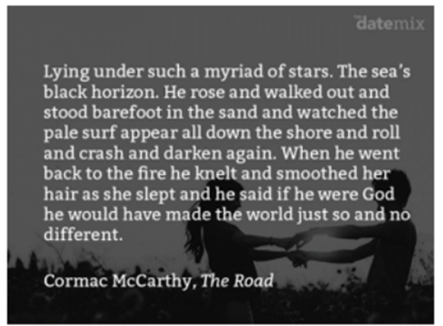
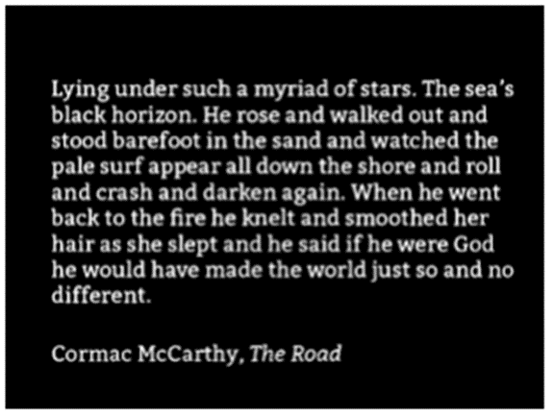
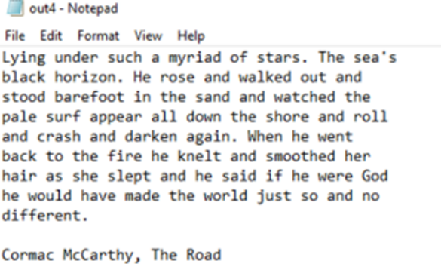
Simulation: Image Processing Using Python
Original image
Result after reducing noise
Result after thresholding
Final Result

Slide 7
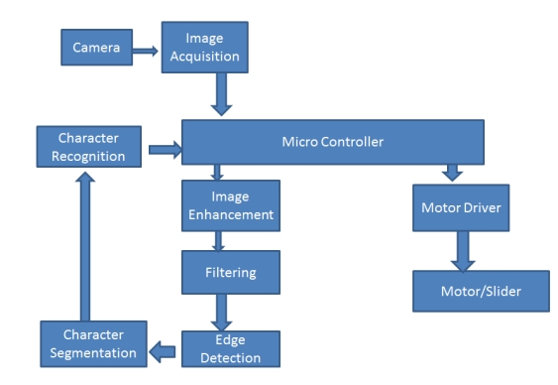
Block Diagram

Slide 8
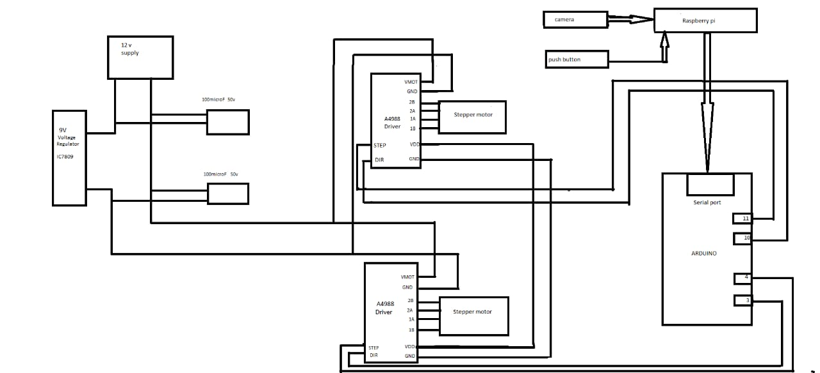
Circuit Diagram

Slide 9
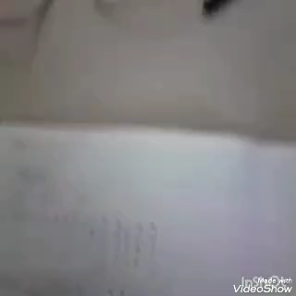
Video

Slide 10
Work Report
Work Completed
Reading a text from image using camera and converting it into text by OCR
Creating braille alphabet according to the text by combination of raspberry pi, Arduino and stepper motor modules
Future Scope
Increasing the number of letters displayed by adding extension modules
The number of motors in modules can be brought down to one by incorporating clutch-gear mechanis
Makee the system much more portable

Slide 11
THANK YOU

